Slide 1
OPtics
UNIT II
Interference - Problems

Slide 2
Young’s double slit

Slide 3
Youngs double slit
1. In a double-slit arrangement the slits are separated by a distance equal to 100 times the wavelength of the light passing through the slits. (a) What is the angular separation in radians between the central maximum and an adjacent maximum? (b) What is the distance between these maxima on a screen 50.0 cm from the slits?

Slide 4
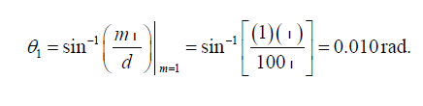


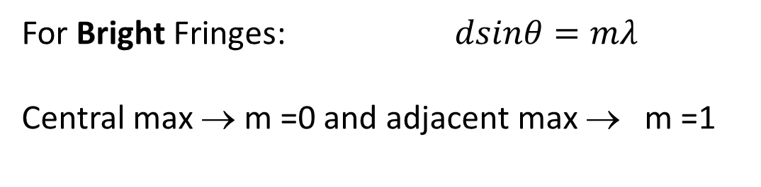
Youngs double slit
In a double-slit arrangement the slits are separated by a distance equal to 100 times the wavelength of the light passing through the slits. (a) What is the angular separation in radians between the central maximum and an adjacent maximum? (b) What is the distance between these maxima on a screen 50.0 cm from the slits?
Solution
For Bright Fringes: $dsinθ=mλ$
Central max → m =0 and adjacent max → m =1
(a)
(b)

Slide 5
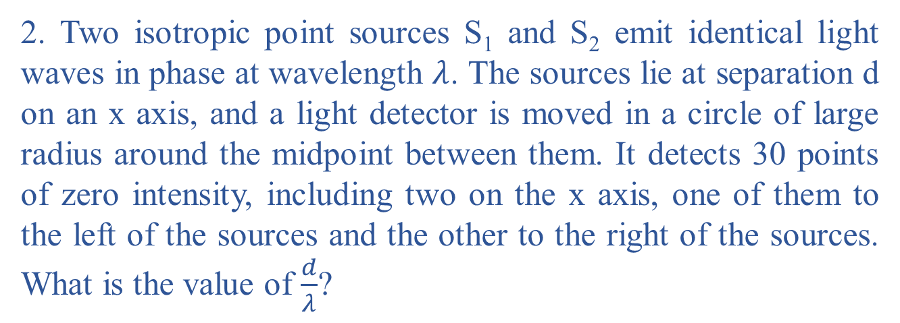
Youngs double slit
2. Two isotropic point sources S₁ and S₂ emit identical light waves in phase at wavelength $λ$. The sources lie at separation d on an x axis, and a light detector is moved in a circle of large radius around the midpoint between them. It detects 30 points of zero intensity, including two on the x axis, one of them to the left of the sources and the other to the right of the sources. What is the value of $\frac{d}{λ}$?

Slide 6

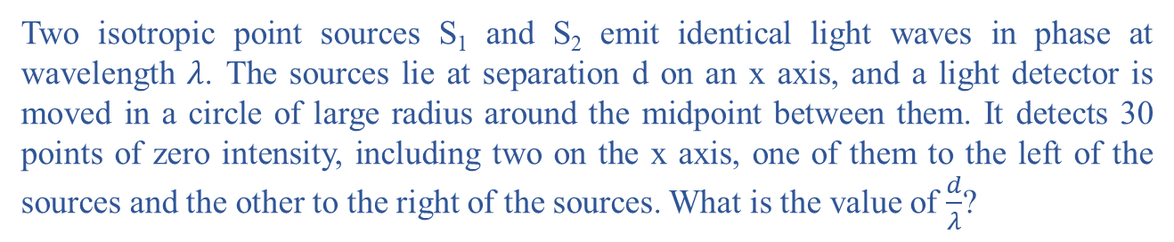
Youngs double slit
Two isotropic point sources S₁ and S₂ emit identical light waves in phase at wavelength $λ$. The sources lie at separation d on an x axis, and a light detector is moved in a circle of large radius around the midpoint between them. It detects 30 points of zero intensity, including two on the x axis, one of them to the left of the sources and the other to the right of the sources. What is the value of $\frac{d}{λ}$?
Solution
P
min
min

Slide 7
Solution
max
P
θ
min
min
Thirty points of destructive implies there are 7+1+7=15 on each side of the y axis
any point on the y axis correspond to a zero phase difference: Sources are coherent
7 “dark” points in the first quadrant, one along the +x axis, and 7 in the fourth quadrant, constituting the 15 dark points on the right-hand side of the y axis

Slide 8

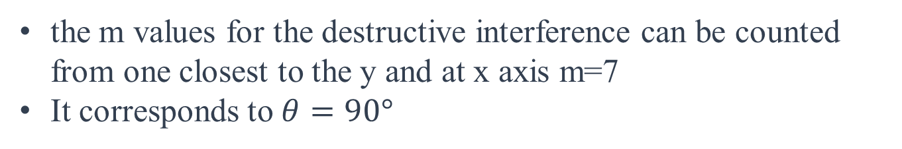
Solution
the m values for the destructive interference can be counted from one closest to the y and at x axis m=7
It corresponds to $θ=90°$
max
P
θ
min
m= 7

Slide 9
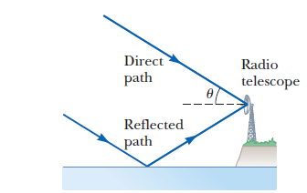
Youngs double slit
3. Radio waves from a star, of wavelength 250 m, reach a radio telescope by two separate paths, as shown in Figure. One is a direct path to the receiver, which is situated on the edge of a cliff by the ocean. The second is by reflection off the water. The first minimum of destructive interference occurs when the star is u 5 25.0° above the horizon. Find the height of the cliff. Assume no phase change on reflection.

Slide 10
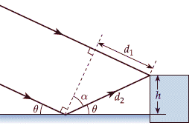
Youngs double slit
Radio waves from a star, of wavelength 250 m, reach a radio telescope by two separate paths, as shown in Figure. One is a direct path to the receiver, which is situated on the edge of a cliff by the ocean. The second is by reflection off the water. The first minimum of destructive interference occurs when the star is u 5 25.0° above the horizon. Find the height of the cliff. Assume no phase change on reflection.
Solution
Path difference

Slide 11



Youngs double slit
Solution
Path difference
First minimum

Slide 12

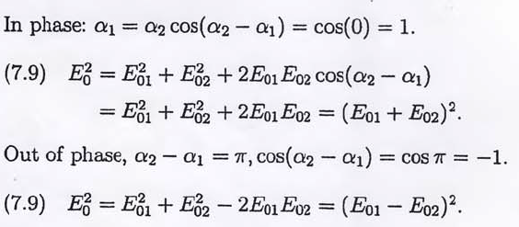
Principle of superposition
Show that when the two waves of the form
are in-phase , the resulting amplitude squared is a maximum equal to (E₀₁ + E₀₂)², and when they are out-of-phase it is a minimum equal to (E₀₁ - E₀₂)².
Solution

Slide 13
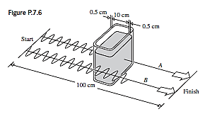
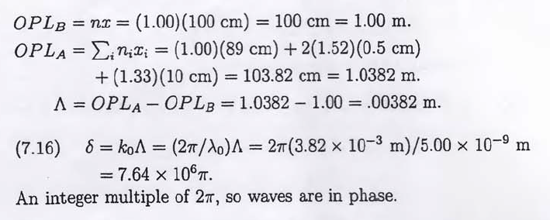
Principle of superposition
Determine the optical path difference for the two waves A and B,
both having vacuum wavelengths of 610nm as shown in figure; the
glass (n = 1.52) tank is filled with water (n = 1.33). If the waves start
in-phase and all the above numbers are exact, find their relative
phase difference at the finishing line.
Solution

Slide 14
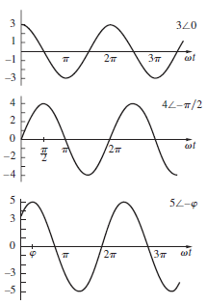
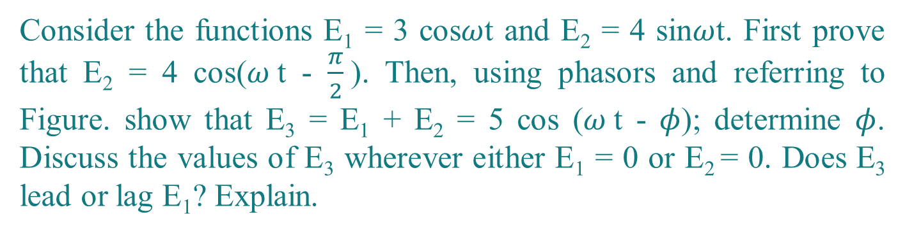
Principle of superposition- Homework
Consider the functions E₁ = 3 cos$ω$t and E₂ = 4 sin$ω$t. First prove that E₂ = 4 cos($ω$t - $\frac{π}{2}$). Then, using phasors and referring to Figure. show that E₃ = E₁ + E₂ = 5 cos ($ω$t - $φ$); determine $φ$. Discuss the values of E₃ wherever either E₁ = 0 or E₂ = 0. Does E₃ lead or lag E₁? Explain.
Solution

Slide 15
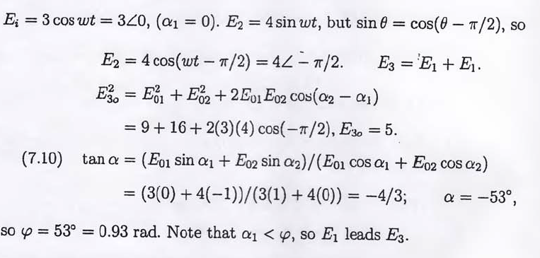
Interference- Numerical
Principle of superposition- Homework
Solution

Slide 16





Interference- Numerical
Intensity
In the double-slit experiment of, the viewing screen is at distance D 4.00 m, point P lies at distance y = 20.5 cm from the center of the pattern, the slit separation d is 4.50 mm, and the wavelength is 580 nm. (a) Determine where point P is in the interference pattern by giving the maximum or minimum on which it lies, or the maximum and minimum between which it lies.(b) What is the ratio of the intensity I_{P} at point P to the intensity I at the center of the pattern?
Solution

Slide 17




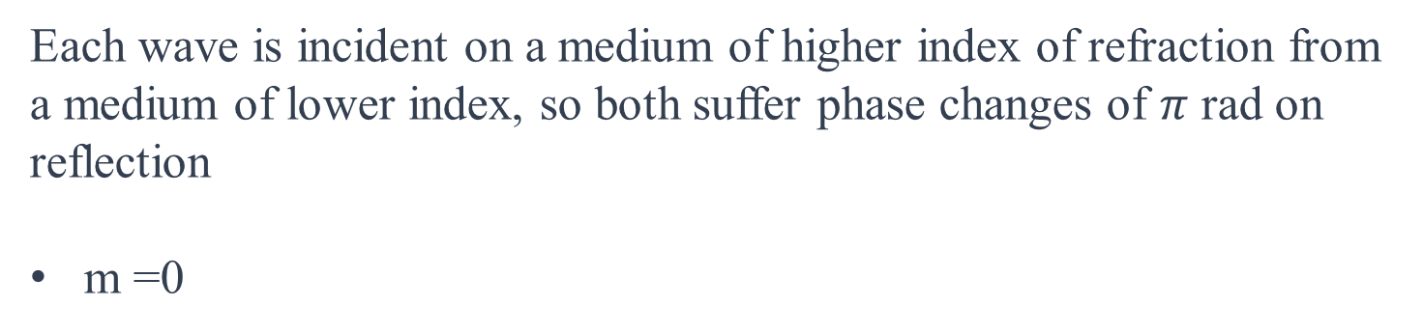
Interference in Thin films
If we wish to coat flat glass (n =1.50) with a transparent material (n 1.25) so that reflection of light at wavelength 600 nm is eliminated by interference, with what minimum thickness the coating have to be done?
Solution
Each wave is incident on a medium of higher index of refraction from a medium of lower index, so both suffer phase changes of $π$ rad on reflection
m =0

Slide 18


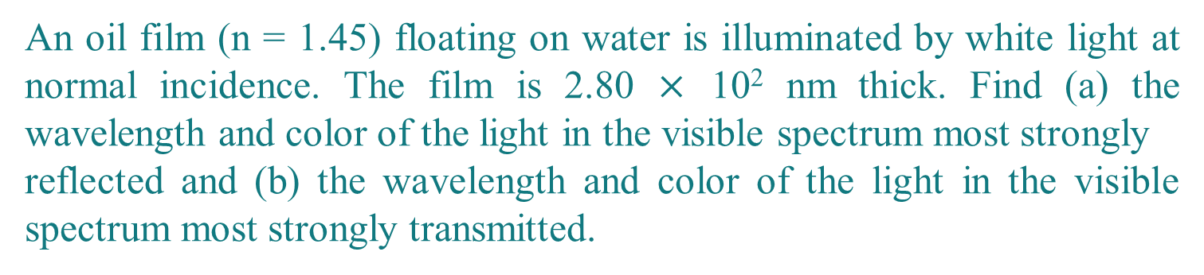
Interference in Thin films
An oil film (n = 1.45) floating on water is illuminated by white light at normal incidence. The film is 2.80 $×$ 10² nm thick. Find (a) the wavelength and color of the light in the visible spectrum most strongly
reflected and (b) the wavelength and color of the light in the visible spectrum most strongly transmitted.
Solution
reflections at the air-oil interface experience a phase change
reflections at the oil-water interface experience no phase change
constructive interference
visible portion of the spectrum 541 nm: Green

Slide 19
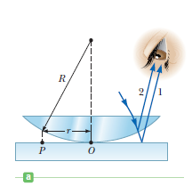
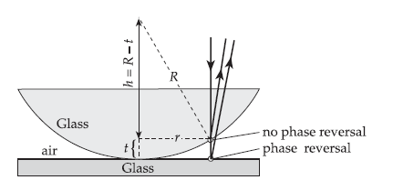

Newton’s Rings
A plano-convex lens with radius of curvature R =3.0 m is in contact with a flat plate of glass. A light source and the observer’s eye are both close to the normal, as shown in Figure. The radius of the 50th bright Newton’s ring is found to be 9.8 mm. What is the wavelength
of the light produced by the source?
Solution

Slide 20


Newton’s Rings
A plano-convex lens with radius of curvature R =3.0 m is in contact with a flat plate of glass. A light source and the observer’s eye are both close to the normal, as shown in Figure. The radius of the 50th bright Newton’s ring is found to be 9.8 mm. What is the wavelength
of the light produced by the source?
Solution
the condition for a bright fringe is (only one phase change)
At the 50th bright fringe, m = 49

Slide 21
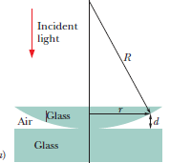


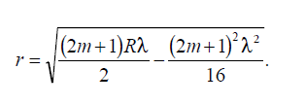


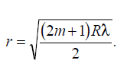

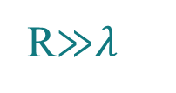
Newton’s Rings
The lens in a Newton’s rings experiment has diameter 20 mm and radius of curvature R 5.0 m. For wavelength of 589 nm in air, how many bright rings are produced with the setup (a) in air and (b) immersed in water (n 1.33)?
Solution
the condition for maximum intensity
R≫$λ$

Slide 22



Newton’s Rings
The lens in a Newton’s rings experiment has diameter 20 mm and radius of curvature R 5.0 m. For wavelength of 589 nm in air, how many bright rings are produced with the setup (a) in air and (b) immersed in water (n 1.33)?
Solution
(b)
m = 33
First bright fringe m=0
Hence 34th Bright Fringe

